Slide 1
Chatbots Using LLMs
We will discussing about use of LLM as base for our chatbot.

Slide 2
Why do we need a LLM?
Creating chatbot with sources such as Rasa/RasaX etc. leads to response that are less creative as they user the developers given outputs or from limited knowledge base. Whereas, Using LLM that are usually trained on larger dataset can lead to more creative answer and feels more human like.
LLMs are better in case chatbot refers to same topic more than once in a conversation with the user. In such cases the responses from the Chatbot may seem monotonous.
Hence we can say that LLM is more appropriate for creating a Chatbot to make it more interactive.

Slide 3
Drawbacks Of LLMs
Choosing LLM that have been trained on smaller database or insufficient parameters can lead to various errors while producing a response by the LLM.(Error percentage is very minute in bigger LLMs like GPT4 etc)
LLM are particularly needed in Tasks requiring narrow range of knowledge and accuracy.

Slide 4
How do we actually use any LLM for chatbot?
If we talk about using any pre-trained LLM for a chatbot. The Use of chatbot is only in 1 step Generating a response from a prompt.
Process:
We create a database with some questions and their corresponding answers.
Whenever user prompts the chatbot we match the similarity of the prompt with already existing questions stored in the database.
We retrieve the answer corresponding to the question that matched with the prompt earlier and save that into a variable lets say context.
Now we make a prompt using this context as well as the question for LLM to generate the answer.
The above method allows us to even answer the question of the user from a much larger context.
Source: Build your Chatbot with Dolly , Official Databricks Video.
Link: https://pages.databricks.com/202305-APJ-VE-Build-your-Chatbot-with-Dolly_01.OnDemand-Thank-You-webinar-OD.html

Slide 5
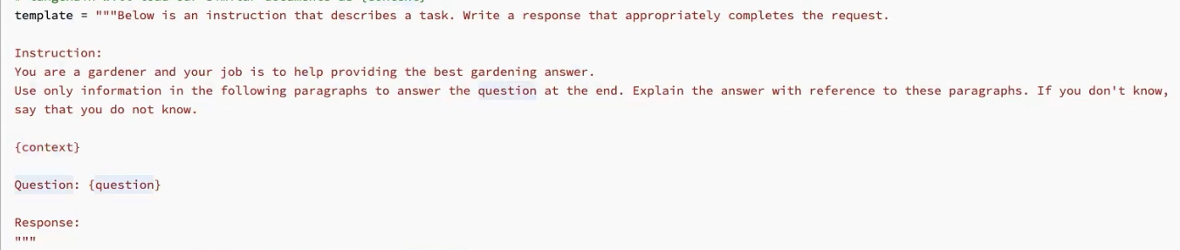
Prompt Template Example

Slide 6
Which LLMs we can use?
We can use different LLMs but most of them have a paid license. So, recently two major Open Source LLMs have been launched:
Dolly: Made By Databricks is a Opensource LLM. It is available in different version based on the number of parameter in the model namely, 3 billion, 7 billion and 12 billion model.
Falcon: Made TII(Technology Innovation Institute) is also an Opensource LLM launched about a month ago. It also available in 2 versions that are namely 7 billion and 40 billion parameter model.
Some other LLMs are also present but are either too expensive on computation or are less accurate.

Slide 7
Dolly v/s Falcon
Dolly
falcon
Dolly is a Open source LLM. It is the first Information tuned LLM i.e. It has been trained on human generated instruction pairs. So, It is able to perform well in context to writing something and generates more human like performance
Dolly has been tuned on about 15000 human generated instruction pairs. This Dataset is generated by Databricks Itself.
Falcon is a recently launched LLM. It topped the OpenLLM leaderboard on HuggingFace. It is has been trained on various web resources so along with English it also capable of generating good quality responses in German and French.
40 billion parameter has been trained on a dataset with about 1 trillion tokens and 7 billion variant has been trained on about 1.5 trillion tokens

Slide 8
Advantages of Falcon
Falcon boast that its model uses only 75 percent of GPT-3’s training compute, 40 percent of Chinchilla’s, and 80 percent of PaLM-62B’s.
Falcon also has an instruct version for both 7b and 42b model which has been finetuned on Baize dataset which itself has about 100k dialogs that have been generated by ChatGPT by letting it converse with itself and it’s performance has been further improved using Alpaca’s data. It also contains 54K/57K/47K dialogs from Quora, StackOverFlow and MedQuAD questions
Token Size(Number of token that can be processed by the LLM at once) of Falcon (16384 tokens) is considerably larger than Dolly (1024 tokens).

Slide 9
Drawback of a Larger LLM
Larger Model generally larger inference time compared to smaller models with lesser parameter but if fine tuned and trained properly, Larger Models are able to more flexible and creative answers as compared to smaller model.

Slide 10
How do we integrate LLM to a Chatbot
Overall Steps can be as follows:
We use haystack for question generation and many software are there that can produced answers for a given question given the data source. We store it in a database.
We take in any input from user and run similarity check on input with questions available in database.
We take the answer corresponding to the question that passes similarity check and pass it on to the pre-trained LLM in form of context along with the question.
Answer to the user input is given by LLM using language generation. This increases the versatility of the chatbot in answering user queries.
We can also integrate summarizing tools in case the answer generated by the LLM is too broad.
LLM can also be helpful in keeping track of previous conversation by giving the summary of previous conversation as input to LLM in form of prompt along with context and question.

Slide 11
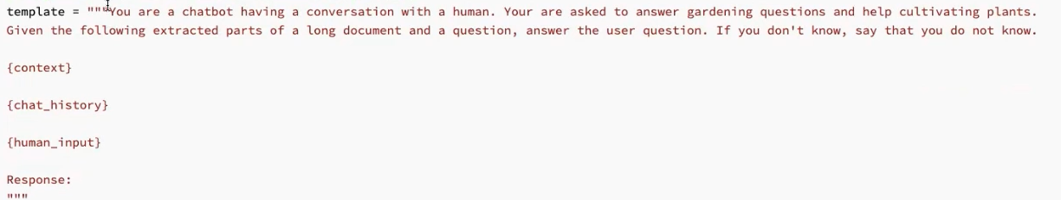
LLM Prompt for Chain Question

Slide 12
Falcon Licensing
I researched for the licensing of Falcon.
This is the link to the licensing guide for falcon: https://www.apache.org/licenses/LICENSE-2.0
But I also got this License Information from the Youtube Video from 1 month ago:
On the next slide ->

Slide 13
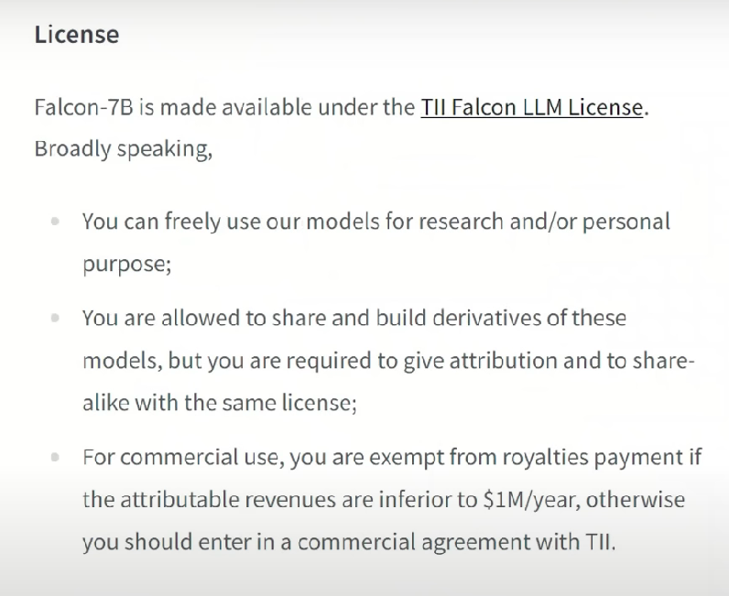

Slide 14
Conclusion
So, we can choose between different LLM and their number of parameter according to our use. We will need to keep in mind time consumption as well as accuracy of the chosen LLM for a better performance chatbot.

